Slide 1
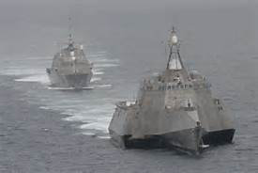
Single Missile - Multiple Target FIREX DOE
Test Planning Considerations:
Factors being held constant:
Swarm characteristics (composition, spacing, formation, speed)
Ship radar mode, selection will be based on NF TRACKEX DOE
Response variable: Miss-Distance was selected as a continuous variable surrogate for P(hit) for DOE sizing purposes
Signal to Noise for Power calculation reduced due to use of continuous surrogate
Environmental conditions such as sea state will be uncontrolled variables
Mitigated through run matrix randomization and recorded during execution
Test Design Factors
Test Input-Process-Output Diagram
Response Variable
Target Maneuver (categorical, 2 levels)
Miss Distance (primary)
Target Quantity (categorical, 2 levels)
Launch Range (continuous, 3 levels)
Position Error**
Approach Angle (categorical, 2 levels)*
Range Rate Error**
Ship Maneuver (categorical, 2 levels)
*Approach Angle = Approximation of approach geometries for various mission types; approach angle may change to a continuous variable based on TRACKEX DOE results (this will not impact run matrix)
** Response variables will be evaluated at each handover instead of the entire run.

Slide 2
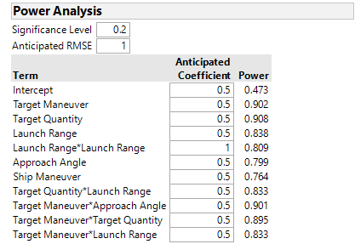
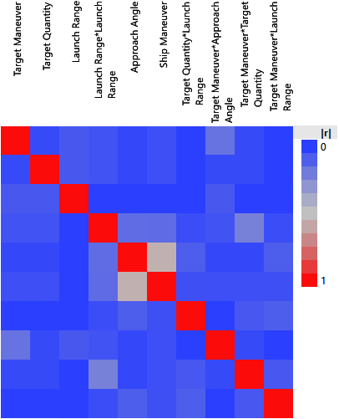
Single Missile - Multiple Target FIREX DOE
Response Variable: Miss Distance
DOE Design Type: D-Optimal
Runs: 29
Power Settings: α = 0.2; 1σ difference in response
Design Notes:
In TRACKEX DOE, target drop was intended to simulate SSMM destruction of targets; therefore not included here.
In TRACKEX, Radar Mode was intended to identify optimum radar mode for conducting firings; therefore FIREX DOE intended to be run in identified radar mode.
Target Quantity assumes unresolved targets; intended to provide insight into track composition effect on Probability of Hit for a single missile shot.
3 center points included to measure variability & test curvature on quadratic.
Factor level values will be defined in the test plan.
 | TRACKEX Factors, Levels, & Interactions
 | Factor Name | Type | #Levels | Levels
A | Target Maneuver | categorical | 2 | L1: Weave L2: Radial
B | Target Quantity | categorical | 2 | L1: low L2: high
C | Launch Range | continuous | 3 | L1: min L2: mid L3: max
D | Approach Angle | categorical | 2 | L1: 0º L2: 45º
E | Ship Maneuver | categorical | 2 | L1: maneuver L2: none
Two-Factor Interactions: A*B, A*C, A*D, B*C, B*E Quadratic: Launch Range * Launch Range Disallowed combination: Approach Angle L2 & Ship Maneuver
Sufficient power on main effects, 2FIs, and quadratic, with exception of Ship Maneuver. Reason is disallowed combination, so less data points. Additional 3-5 runs required to get power >0.8.
Higher correlation between Approach Angle * Ship Maneuver is unavoidable due to disallowed combination. This is acceptable for the design.

